Slide 1
Customer Segmentation for Online Retail Agency
Author
Nithin Das
Instructor
M. Daneshmand

Slide 2
Content
Problem Statement
Software Used
Data Description
Data Preprocessing
Exploratory Data Analysis
Data Preparation
Data Normalization
Finding ‘K’ value
K means Clustering
EDA on clusters
Best Selling Items
Documentation
Conclusion

Slide 3

Problem Statement
A leading UK based non-store online retail agency wants to segment their customers
to improve their marketing strategies
Why Customer Segmentation?
A customer segmentation model allows for the effective allocation of
marketing resources and the maximization of cross and up-selling opportunities.
How is it Achieved?
Customer segments are usually determined on similarities, such as personal
characteristics, preferences or behaviors that should correlate with the same behaviors that drive customer profitability.

Slide 4
Software Used
Python
IDE: Jupyter Notebook
Packages: Pandas, Numpy, matplotlib, Sklearn

Slide 5
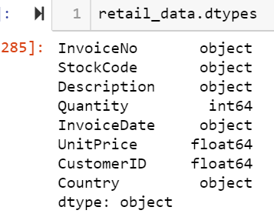
Data Description
Total Records = 541909
Variables = 'InvoiceNo', 'StockCode', 'Description', 'Quantity', 'InvoiceDate', 'UnitPrice', 'CustomerID', 'Country’

Slide 6
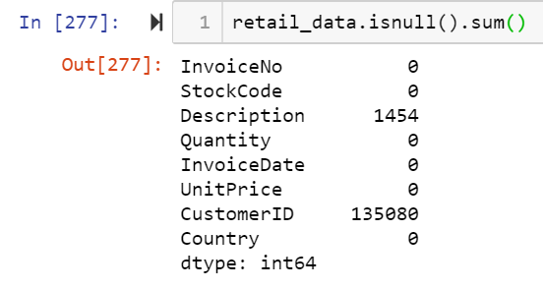
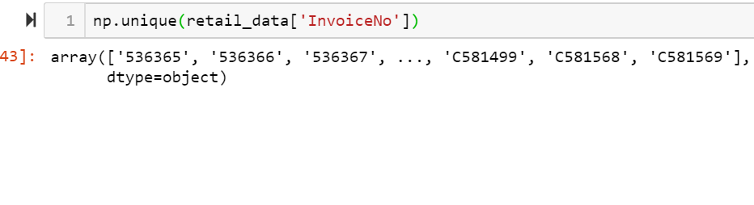
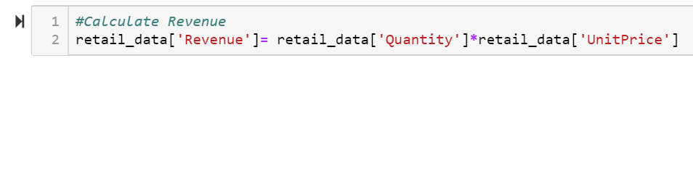
Data Preprocessing
The ‘Description’ variable has 1454 missing values and ‘CustomerID’ has 135080 missing values
We will remove these missing values
The “Invoice” variable has values that starts with “C”, which
Denotes cancelled transactions. We will have to remove such
Transactions to derive meaningful insights
After the above steps, we are left with 397924 records
We can also calculate Revenue as “Quantity” * “Unit Price”

Slide 7
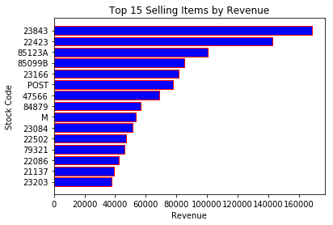
Exploratory Data Analysis

Slide 8
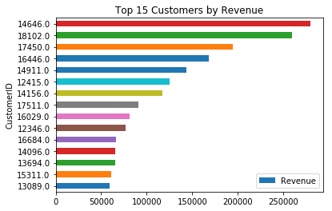
EDA (continued)

Slide 9
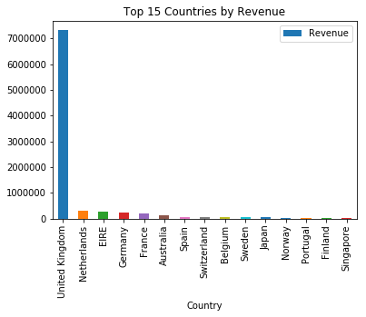
EDA (continued)

Slide 10
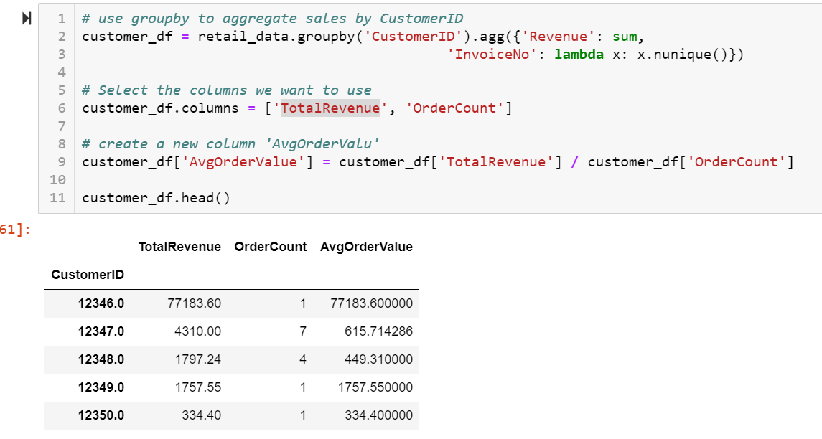
Data Preparation
For customer segmentation, we have to create characteristics for customers
Therefore we aggregate “Revenue” and “Invoice No”
to get Total Revenue and Order Count for each customers
We can also calculate “Average Order Value”
for each customers as
“Avg. order value”= “Total Revenue”/ “Order Count”

Slide 11
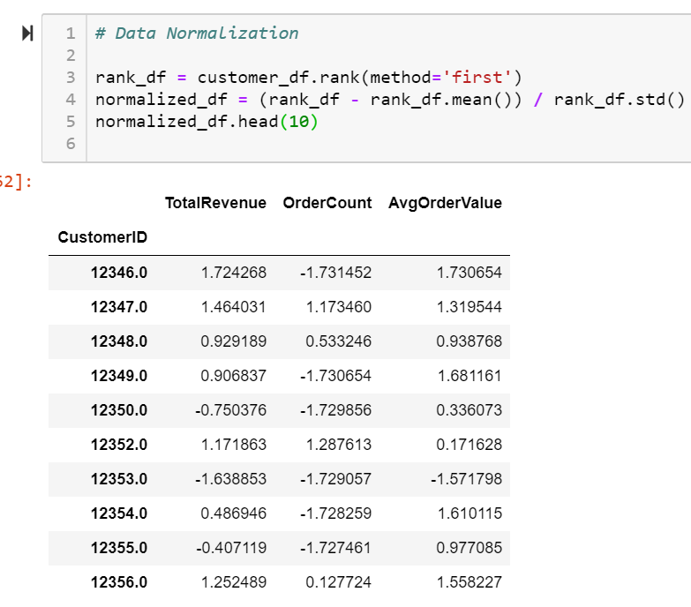
Data Normalization
Before clustering, it is important to normalize the data since the customer characteristics may be measure by variables with different units.
Therefore we will normalize “TotalRevenue”,
“Order Count” and “ Avg Order Value”

Slide 12
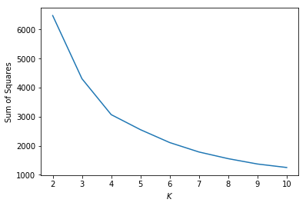
Finding ‘K’ value for Kmeans
Elbow Method:
After k=4, the curve tends
to get flatter
Therefore, e will set total clusters equals 4

Slide 13
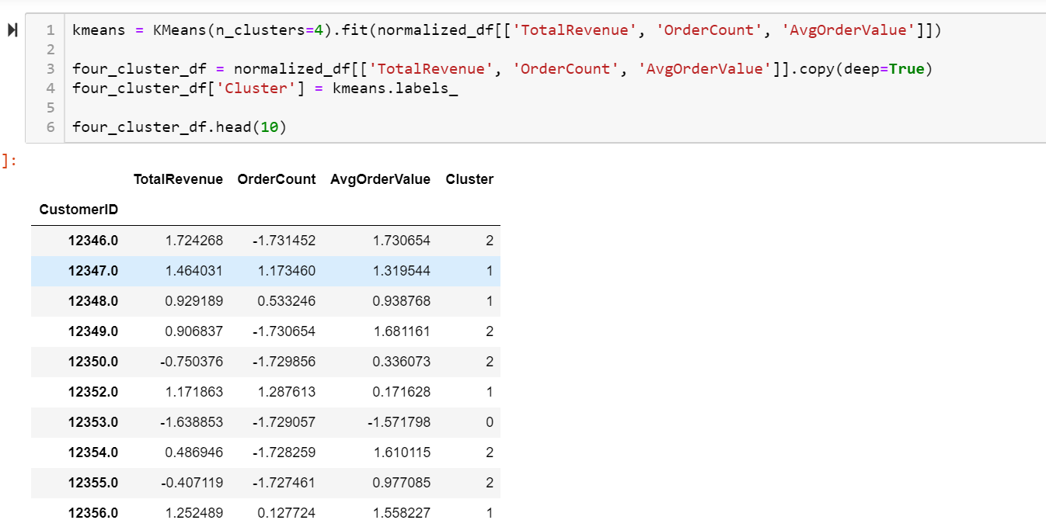
K means Clustering
Each customers are assigned in to one of the 4 clusters

Slide 14
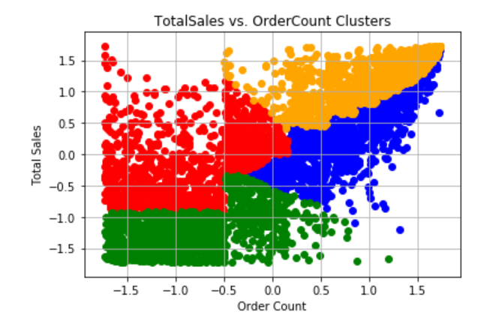
EDA on obtained clusters
The customers in green have low total sales/revenue and low order count,
meaning they are all-around low-value customers. On the other
hand, the customers in orange have high total sales and high
order counts, indicating they are the highest value
customers.

Slide 15
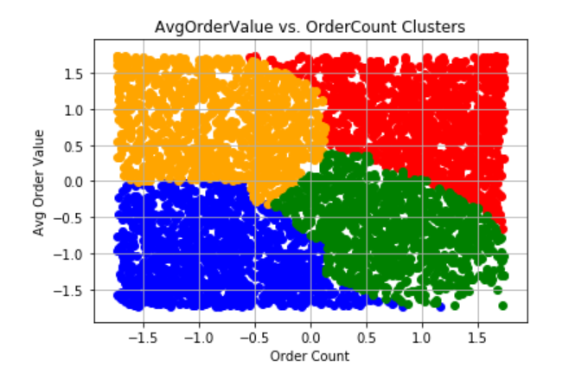
EDA on the clusters
The customers in blue are the lowest value customers and the customers in red are the highest value customers.
We could look at the customers in the orange cluster and attempt to find ways to
increase their order count with email reminders or SMS push notifications targeted based
on some other identifying factors.
Likewise, with customers in the green segment, you might want to try some cross-selling and
up-selling techniques at the cart.

Slide 16
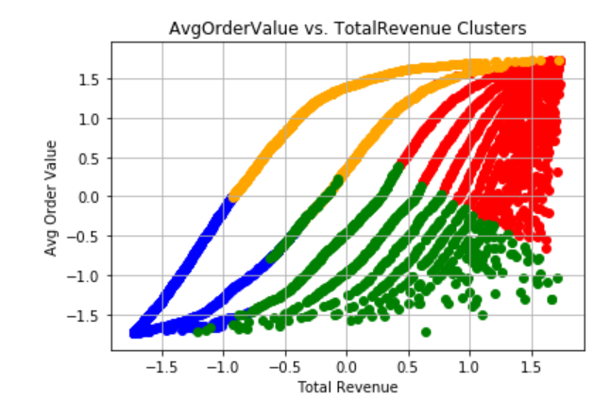
EDA on obtained clusters
In this plot, we have the average order value versus total revenue
clusters. This plot further substantiates the previous 2 plots in
identifying the red cluster as the highest value customers,
blue as the lowest value customers, and the green and orange as high
opportunity customers.

Slide 17
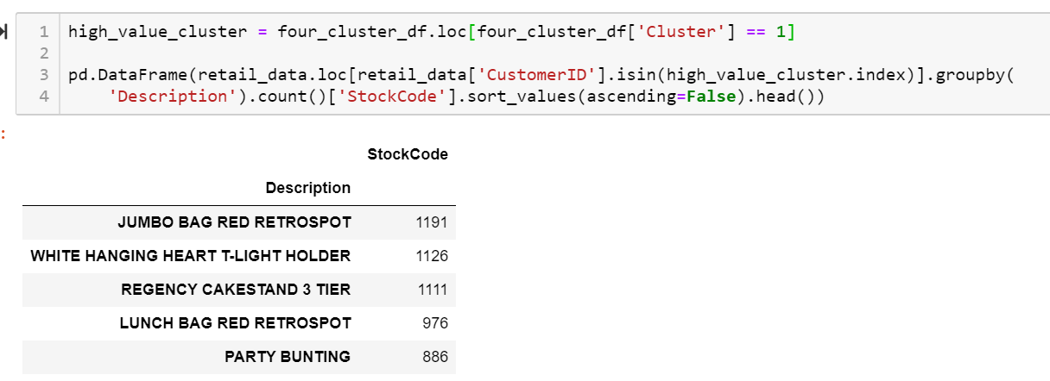
Best selling Item
Based on this information, we now know that the Jumbo Bag Red Retrospot is the best-selling item for our highest-value cluster.
We can also make recommendations of Other Items You Might Like to customers within this segment.

Slide 18
Documentation
https://towardsdatascience.com/k-means-clustering-algorithm-applications-evaluation-methods-and-drawbacks-aa03e644b48a
https://www.analyticsvidhya.com/blog/2019/08/comprehensive-guide-k-means-clustering/

Slide 19
Conclusion
Application of K-means clustering based on the purchasing behaviors of historical customers.
These analysis are useful to recommend more items to the customers under categories like ‘Items You might Like’, ‘Recommendations based on your Usage’ etc.

Slide 20

Thanks!

